Slide 1
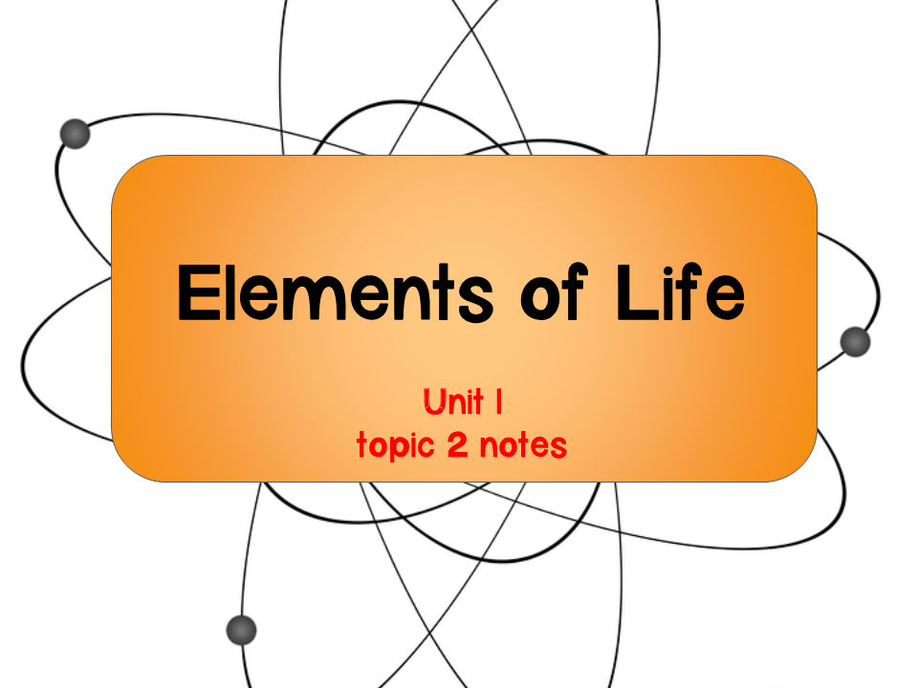

Slide 2
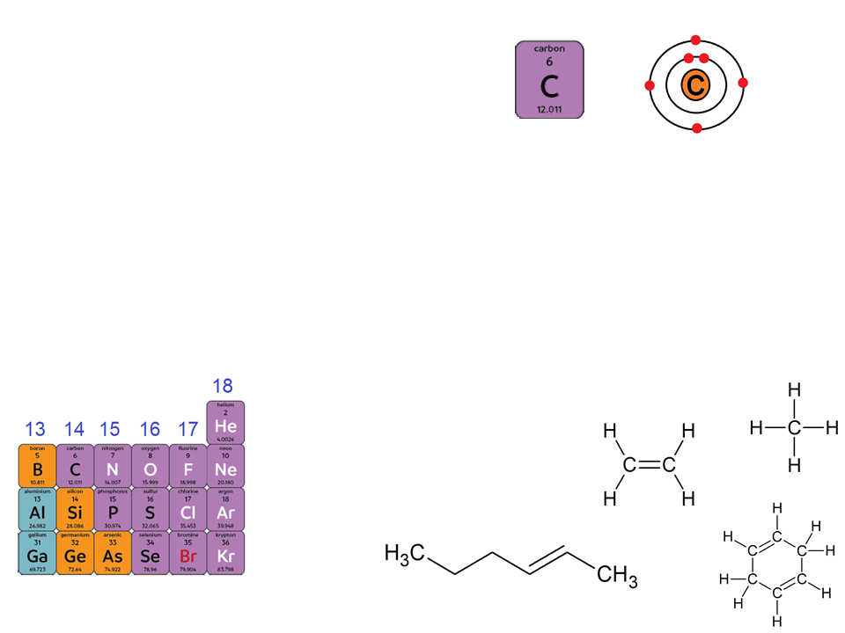
Carbon
Organic chemistry: the study of compounds with covalently bonded carbon
Organic compounds: compounds that contain carbon and hydrogen
Carbon has 4 valence electrons
Notes:
Make sure to emphasize to students that carbon can form diverse molecules because it can bond to four other atoms.
The electron configuration of carbon gives it covalent compatibility with many other elements

Slide 3
Carbon
Carbon can form single, double, or triple covalent bonds
A single carbon can form up to four covalent bonds!
  Can form LONG chains
Most commonly formed with hydrogen, oxygen, and nitrogen
The type and number of covalent bonds carbon forms with other atoms affects the length of the carbon chain and shape of the molecule
Notes:
Make sure to emphasize to students that carbon can form diverse molecules because it can bond to four other atoms.
The electron configuration of carbon gives it covalent compatibility with many other elements

Slide 4
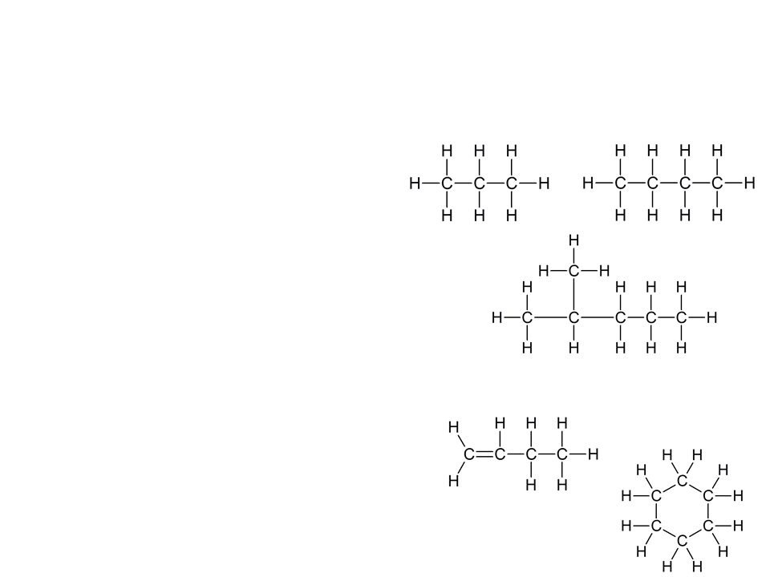
Carbon Chains
Carbon can use its valence electrons to form covalent bonds to other carbons
This links the carbons into a chain
Hydrocarbons- organic molecules consisting only of carbon and hydrogen (think: simple framework for more complex organic molecules)

Slide 5
Carbon Chains
Carbon chains form the skeletons of most organic molecules
Skeletons can vary in:
  Length
  Branching
  Double bond position
  Presence of rings
Many regions of a cell’s organic molecules contain hydrocarbons

Slide 6
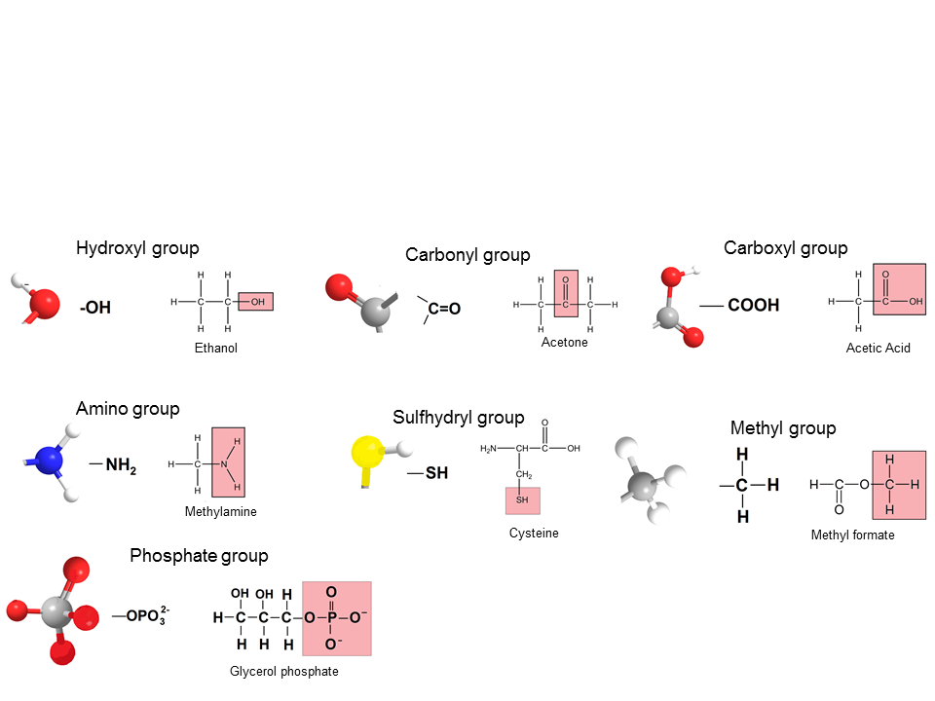
Functional Groups
Functional groups: chemical groups attached to the carbon skeleton that participate in chemical reactions

Slide 7
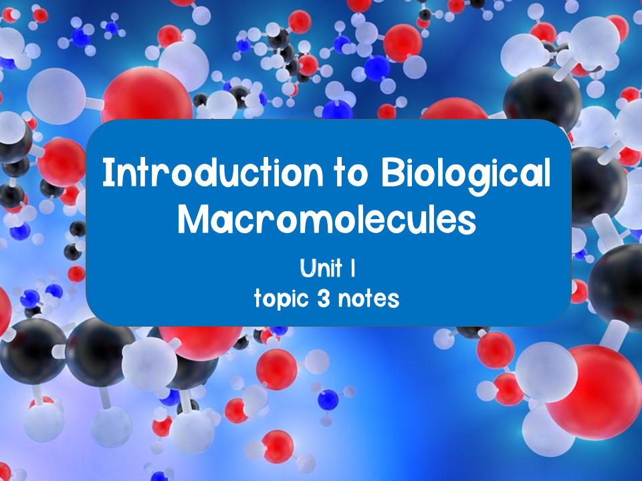

Slide 8
Molecular Diversity due to Carbon
Variations in carbon skeletons allows for molecular diversity
Carbon can form large molecules known as macromolecules
Four classes of macromolecules (molecules made of smaller subunits):
Carbohydrates
Proteins
Nucleic acids
Lipids
NOTE: Along with carbon, nitrogen is an important element for building proteins and nucleic acids. Phosphorus is important for building nucleic acids and some lipids
Polymers
Does not include true polymers and are hydrophobic molecules

Slide 9
Formation and Breakdown of Macromolecules
Polymers: chain like macromolecules of similar or identical repeating units that are covalently bonded together
Monomers: the repeating units that make up polymers

Slide 10
Formation and Breakdown of Macromolecules
Dehydration reaction: bonds two monomers with the loss of H₂O
The -OH of one monomer bonds to the -H of another monomer forming H₂O, which is then released
  A+B→AB + H₂O
Hydrolysis: breaks the bonds in a polymer by adding H₂O
One -H of the H₂O bonds to one monomer and the remaining -OH of the H₂O attaches to the other monomer
  AB + H₂O → A+B

Slide 11
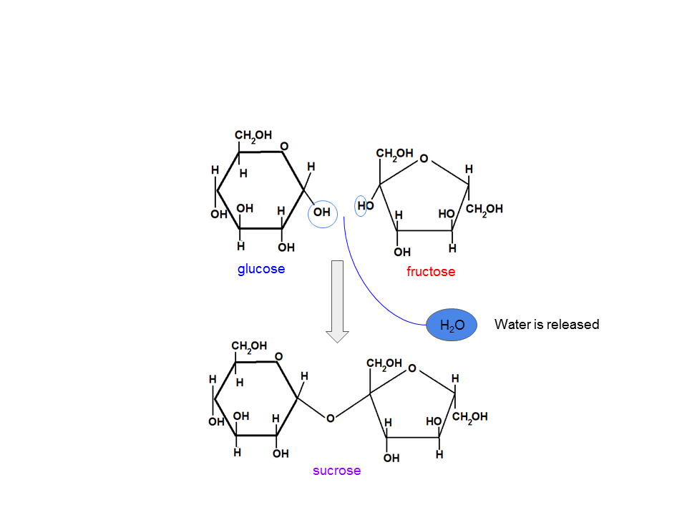
Dehydration Reaction

Slide 12
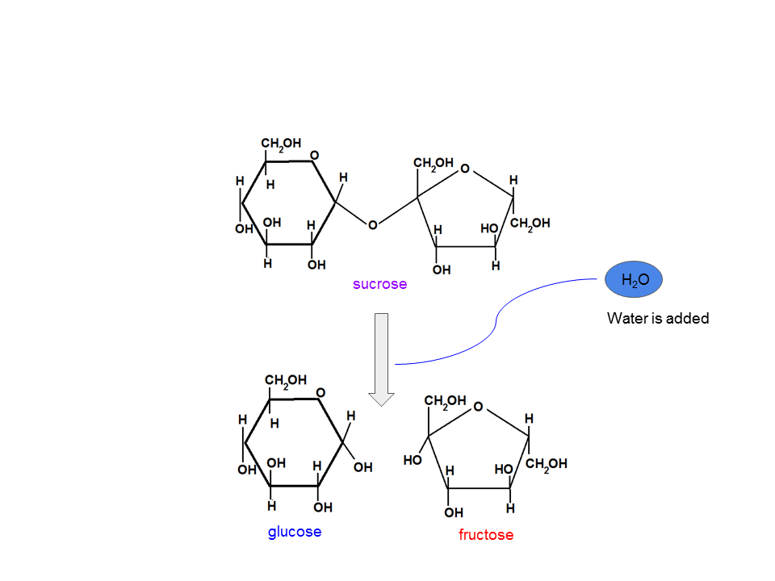
Hydrolysis

Slide 13
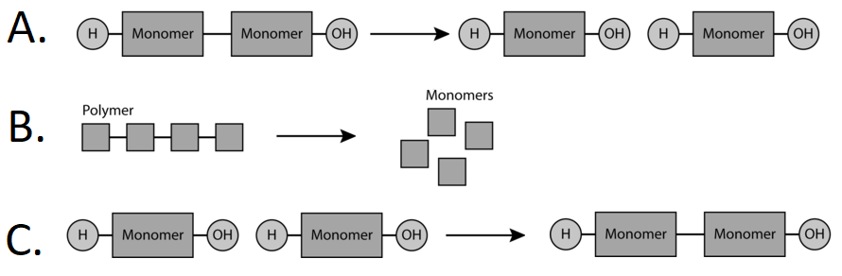
Practice
Using the image above identify the types of reactions occurring and justify your response by demonstrating where water would be added or removed.
Notes:
A and B are hydrolysis reactions, where water is added to break down molecules (polymers being broken down into monomers).
C is a dehydration reaction, where water is removed to join molecules (monomers join to form polymers)

Slide 14
Concept Check
You are performing an experiment that involves a hydrolysis reaction. The polymer that you are working with is amylose starch. There are 300 monomers of glucose that make up this polymer. How many water molecules will you need to completely hydrolyze the amylose starch polymer?
Answer: 299

Slide 15
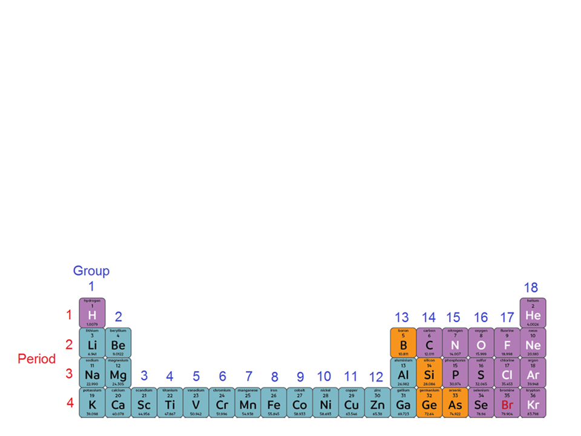
Concept Check
Describe the properties of carbon that make it an element essential for life.
Look at the periodic table and find silicon. What do you notice about its position in comparison to carbon. What does that tell us about silicon?
Notes:
Answers:
2. Carbon can form diverse molecules because it can bond to four other atoms. The electron configuration of carbon gives it covalent compatibility with many other elements.
3. Silicon is in the same group as carbon, meaning it will behave similarly since it has the same number of valence electrons. Interesting fact: if there was more silicon in the universe, life on Earth could have been silicon based, but there was far more carbon, hence, we are carbon based life forms.

